Slide 1
STUDENT PERFORMANCE PREDICTIONS An analysis of anonymized student academic performance data & a machine-learning model to predict future performance
By
Kameron Thao,
Nou Yang,
Mary Vang,
&
William Thomer
For the edX / Tulsa Community College “Cyber Skills Center” Data Analytics Bootcamp, Inaugural Cohort, 2022-2023
(Dataset comes courtesy of Royce Kimmons, http://roycekimmons.com)

Slide 2
Abstract
Analysis of various factors that can impact a high school student's academic performance. The objective of this analysis is to measure any correlation between a student's circumstances & their overall performance on examinations in the subjects of Math, Reading, & Writing.
Further, a machine learning model which has been trained to predict a student’s potential performance in any of these fields based upon the given dataset.

Slide 3
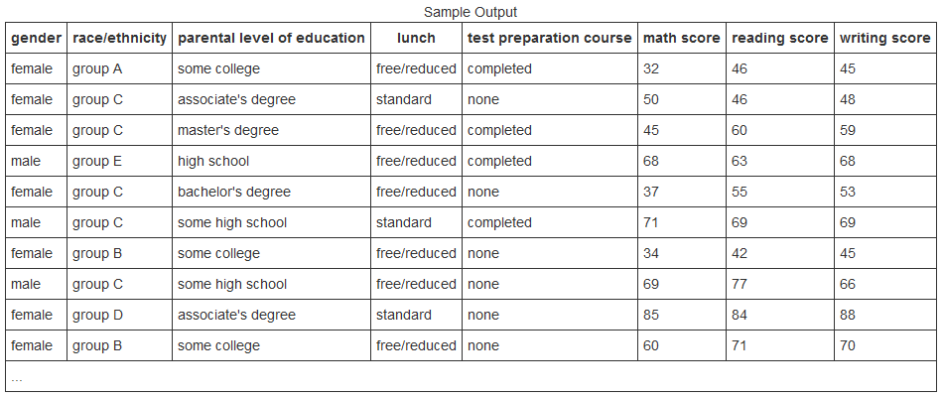
Data Set Courtesy of Royce Kimmons, http://roycekimmons.com © 2012, Royce Kimmons
Data set is a generated sample of 1,000 students in three distinct categories of information:
Individual examination scores in the subjects of Math, Reading, and Writing.
Circumstantial information; their parental education level & if their lunch is standard-cost or provided for free.
Demographic information such; sex & race/ethnicity.

